Slide 1
Some Analyses & Talend
Session 9
Farha Imthiyaz,
BSc (Hons) in Software Engineering
(Solent University, UK),
MS in Data Science (Reading)
(NED University of Engineering & Technology, Karachi)

Slide 2

Road Map
RFM Analysis
Customer Segmentation based on RFM Analysis
Cohort Analysis
Customer lifetime value (Customer LTV)
Talend

Slide 3
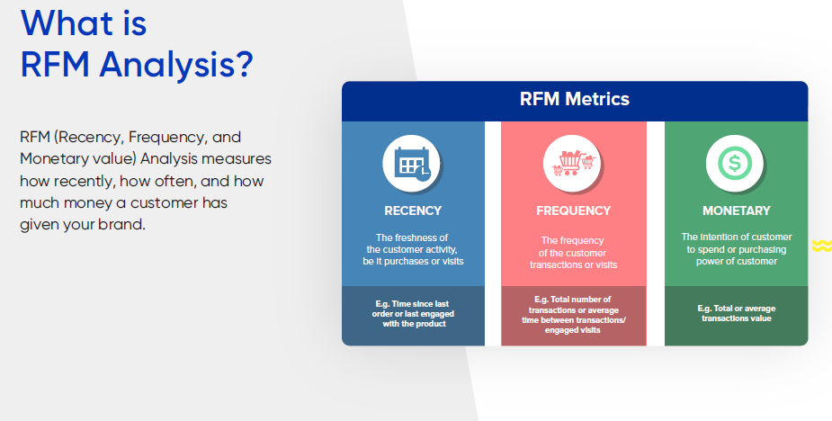
1. RFM Analysis

Slide 4
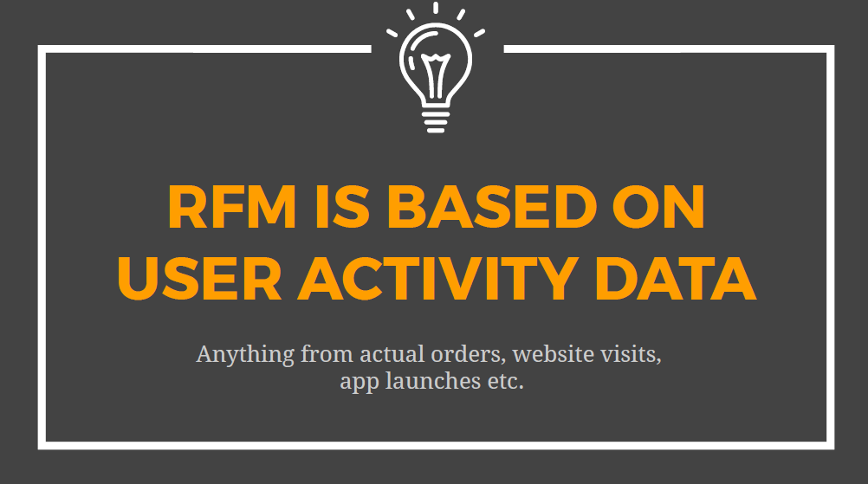

Slide 5
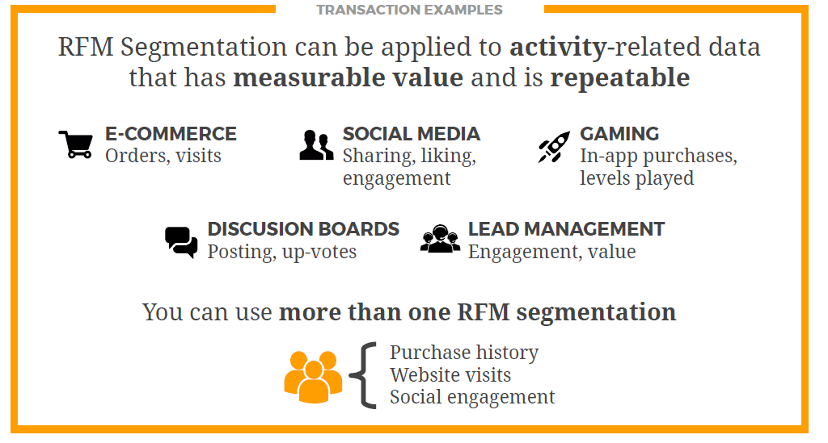

Slide 6
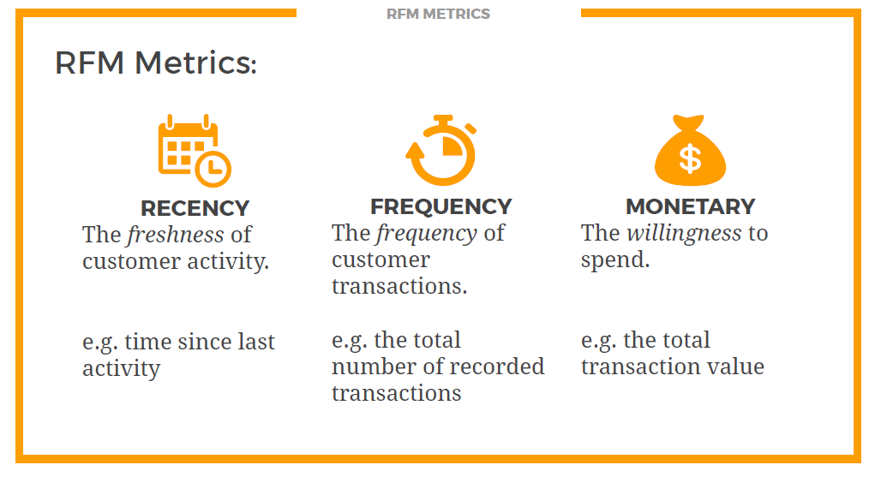

Slide 7
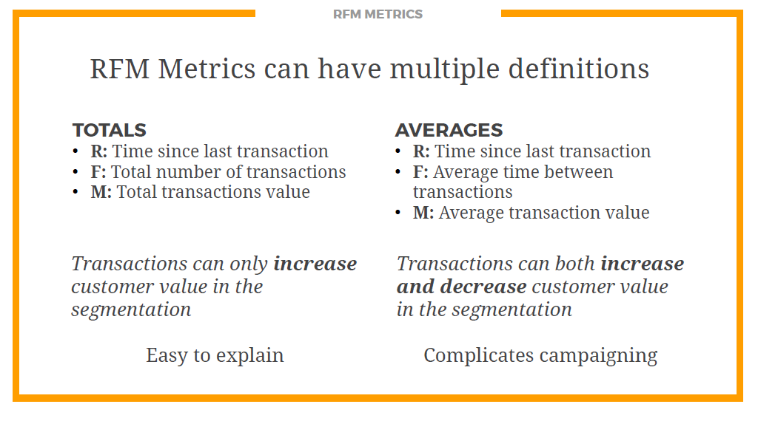

Slide 8
RFM analysis helps marketers find answers to the following questions:
Who are our best customers?
Which of our customers could contribute to your churn rate?
Who has the potential to become valuable customers?
Which of our customers can be retained?
Which of our customers are most likely to respond to engagement campaigns?

Slide 9

2. Customer Segmentation based on RFM Analysis

Slide 10
3. Cohort Analysis
An analytical techniques that focuses on analyzing the behavior of a group of users/customers over time, thereby uncovering insights about the experiences of those customers, and what companies can do to better those experiences.

Slide 11
Here are some factors that can impact user behavior that we may want to analyze with a Cohort Analysis:
Target audience
Ad content
Channels
Campaigns/experiments
Website redesigns
New product lines and service offerings
Sales, discounts, promotion campaigns

Slide 12
Use of Cohort Analysis
Know how user behaviors affect your business
Understand customer churn.
Calculate customer lifetime value.
Create more effective customer engagement.

Slide 13
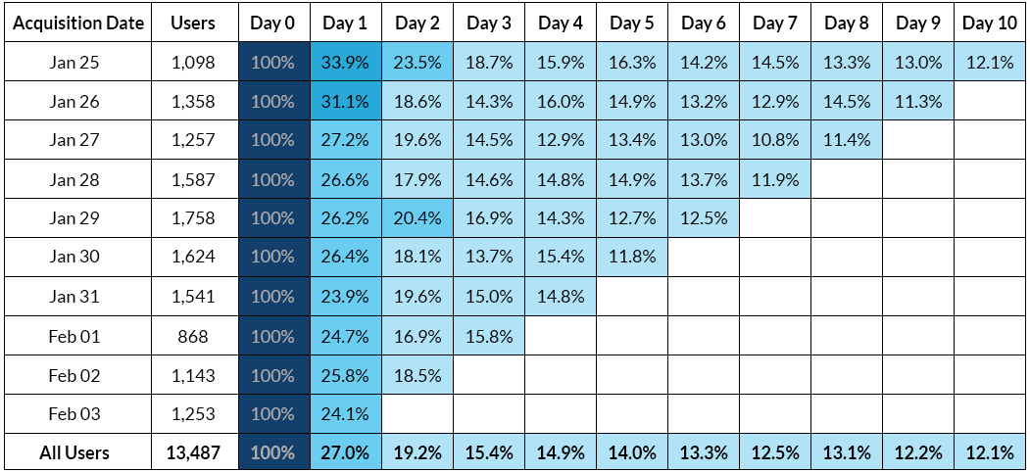
Cohort Analysis Example

Slide 14
4. Customer lifetime value (Customer LTV)
Customer lifetime value (CLTV), represents the total amount of money a customer is expected to spend in our business, or on our products, during their lifetime.
Customer lifetime value is the total worth to a business of a customer over the whole period of their relationship.
It’s an important metric as it costs less to keep existing customers than it does to acquire new ones, so increasing the value of your existing customers is a great way to drive growth.

Slide 15
5. Talend
Talend is an ETL tool for Data Integration.
It provides software solutions for data preparation, data quality, data integration, application integration, data management and big data.
Talend has a separate product for all these solutions.
Data integration and big data products are widely used.

Slide 16
Talend Related Links
https://www.guru99.com/talend-tutorial.html
https://www.tutorialspoint.com/talend/talend_introduction.htm
https://www.edureka.co/blog/talend-etl-tool/

Slide 17


